Slide 1
Bringing Data Science to Life
Recommendations to put data science into practice
Steven Simonsen 4/14/2024

Slide 2
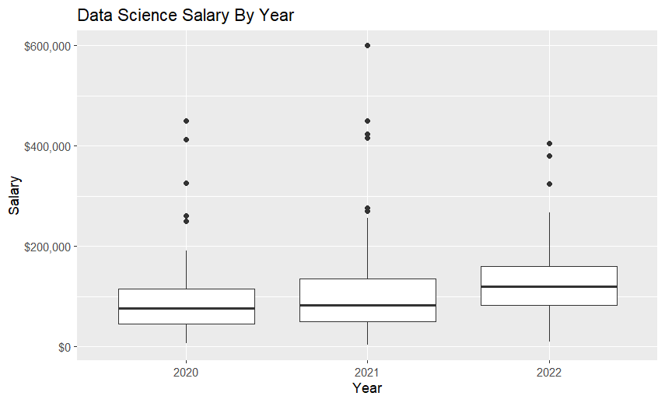
Data Science Salaries – Mean or Median?
There are significant outliers on the high side of data science salaries
This tells us that the median (the middle of the data), as opposed to mean (average), better represents the data
Will use median to discuss analysis on future slides

Slide 3
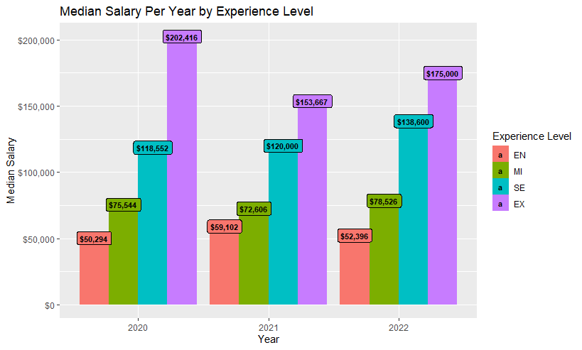
Salary By Experience Level
Median salary generally increases with experience based on the data
However, the gap between levels is closing slightly

Slide 4
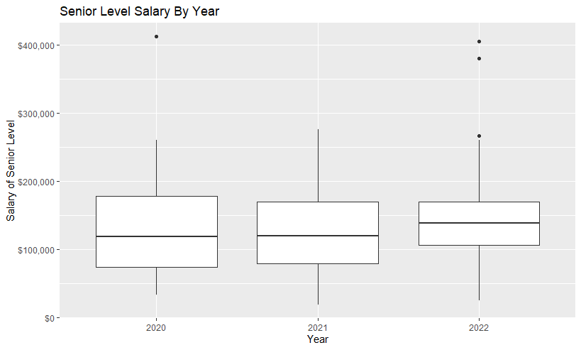
A Closer Look at Senior Level Salaries
In 2022, the summary statistics break down as follows:
1st QT=$100,000
Median=$138,600
3rd QT=$170,000
Again, there are some outliers on the upper side of salary, as indicated by the dots above the graphs.

Slide 5
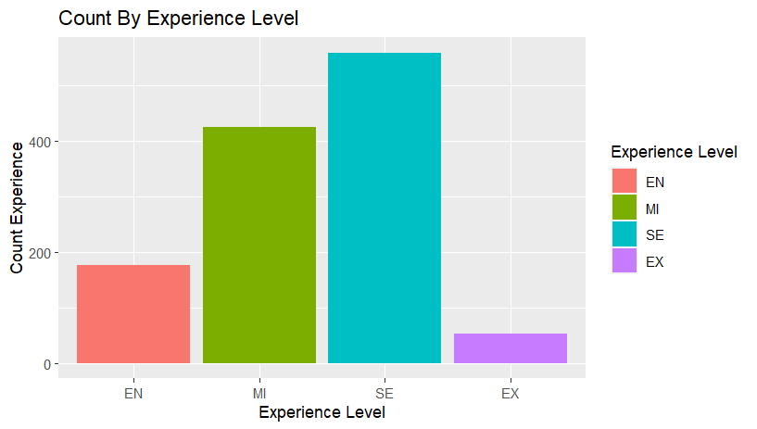
General Industry Experience
More available candidates in Mid and Senior Level
It would therefore be easier to find Mid and Senior Level candidates, as opposed to Executive or Entry Level

Slide 6
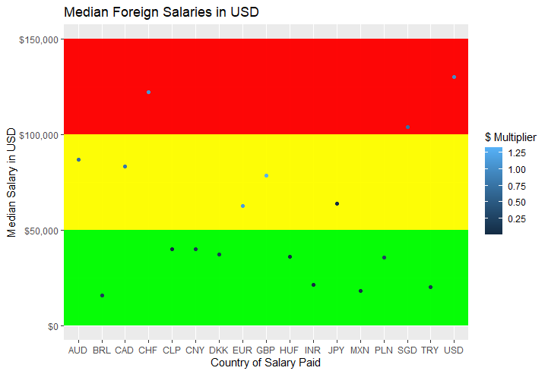
What About International Candidates?
Green means a low median salary in USD, yellow means moderate, and red means high.
The $ Multiplier indicates the value of the country’s currency in relation to USD.
Ex: 0.25 means the country’s currency is worth $0.25 on the dollar
Notice the large candidate pool with low median salaries and a low $ Multiplier

Slide 7
Overall Recommendation
Although it may be tempting to hire internationally for budgeting, there are drawbacks
Working across time zones can lead to long hours, there can be language barriers, and a low $ Multiplier can potentially indicate an unstable economy in foreign countries
Overall Recommendation: Hire a US based Senior Level Data Scientist and pay them between $138,600 and $170,000.
Median salary for Senior Level is $138,600, which I recommend being the low end of the salary range
3rd Quartile for Senior Level is $170,000, which I recommend being the upper end of the salary range
There are more senior level data scientists than any other level, which should increase the number of qualified candidates

